Slide 1
The Statistics on Lost and Found Pets
Kevin Pennell

Slide 2

The Data and Hypothesis
Matched vs Lost
Lizards are there too! As well as a few other animals, but my method removes them by coincidence
Dogs I feel will have dogs show better results, I expect to see similar data overall but with dogs having higher rates of being found

Slide 3
Methods
Bar Graphing
Selecting data to best represent the set
i.e having the 10 cat breeds with the most data sets and the 10 non-dogs with the highest amount of data sets
Taking the averages of the most populated sets

Slide 4
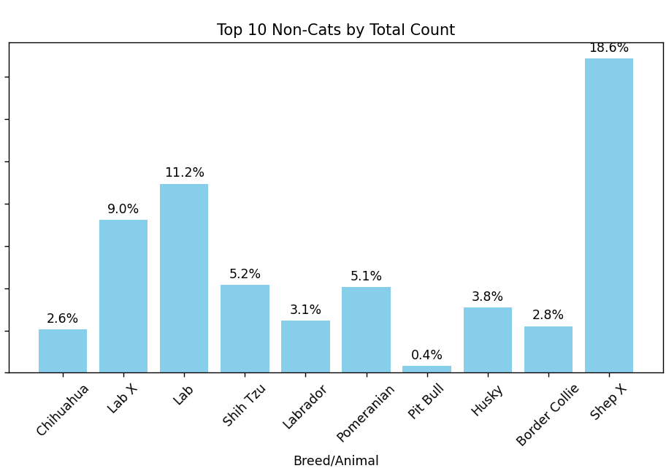
The Dogs
Due to taking the 10 most populated data sets, all non dog extra animals didn’t make the cut
Average found rate: %6.18

Slide 5
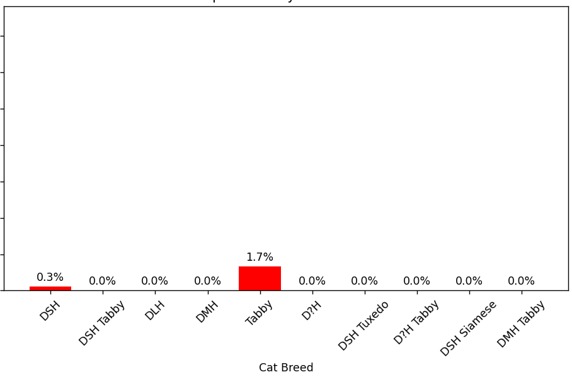
The Cats
Average found rate: %0.2

Slide 6
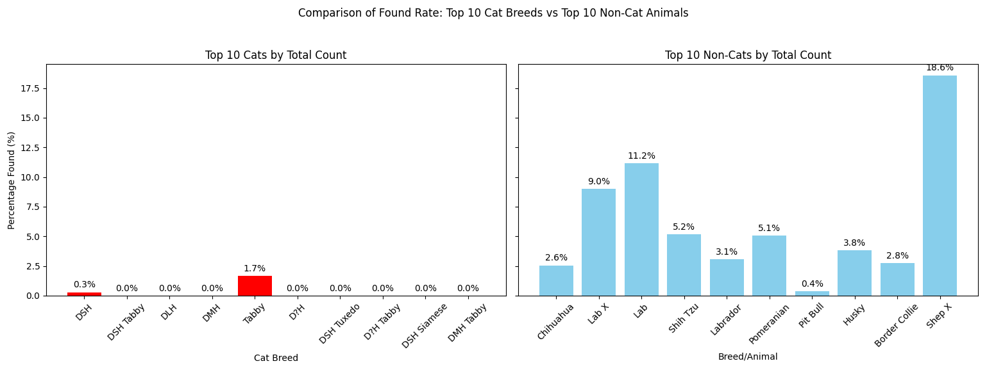

Slide 7
The Results
The results show %6.18 and %0.2 respectively, showing over a 30 times higher match rate with dogs than cats based on the information I looked at
Given this data is accurate it is safe to say that cats have a very very low found rate
Shep X or Shepard mix has the highest found rate by far
All cats but Tabby and DSH had a 0 reported found cases

Slide 8
Hypothesis Reflection
Comparing my finding to my hypothesis I could not have been more wrong
This data to me was fascinating and not at all what I would have expected
Original Hypothesis: dogs will show higher rates of being found due to the nature of loyalty in canines. However, i expect the rates of being found to be like cats, and should show a percentage within 5% of each other
I expected cats to have a far higher found rate

Slide 9
Future Work
1
Observing the Matched data as well, perhaps it may help to understand the vastly different averages
2
Observing perhaps the top 15 or 20 breeds of each animal, maybe with more data the averages will get closer
3
Looking at the impact of the Sex of the animal, does that seem to have any impact?

